Slide 1
Project presentation on :- CUSTOMER RETENTION ANALYSIS
Submitted by :
Vikas Ojha

Slide 2
Table Of Contents :-
1. Introduction
(a) What is customer retention?
(b) Conceptual Background of the Domain Problem
(c) Customer Retention Benefits
2. 5 reasons of customer retention’s growth effecting.
3. Data analysis
4. How to Improve Customer Retention
5. Conclusion
6. Limitations of this work and Scope for Future Work
7. Acknowledgement

Slide 3
INTRODUCTION
What is customer retention?
Customer retention refers to the activities and actions companies and organizations take to reduce the number of customer defections. The goal of customer retention programs is to help companies retain as many customers as possible, often through customer loyalty and brand loyalty initiatives. It is important to remember that customer retention begins with the first contact a customer has with a company and continues throughout the entire lifetime of the relationship.

Slide 4
Conceptual Background of the Domain Problem
Customer satisfaction has emerged as one of the most important factors that guarantee the success of online store, it has been posited as a key stimulant of purchase, repurchase intentions and customer loyalty.
A comprehensive review of the literature, theories and models have been carried out to propose the models for customer activation and customer retention.

Slide 5
Customer Retention Benefits
While most companies traditionally spend more money on customer acquisition because they view it as a quick and effective way of increasing revenue, customer retention often is faster and, on average, costs up to seven times less than customer acquisition.
Selling to customers with whom you already have a relationship is often a more effective way of growing revenue because companies don’t need to attract, educate, and convert new ones.

Slide 6
Ways to Retain Customers
1. Improve ROI
2. Convert more sales
3. Spend less on TOFU marketing
4. Increase customer LTV
5. Earn more referrals

Slide 7
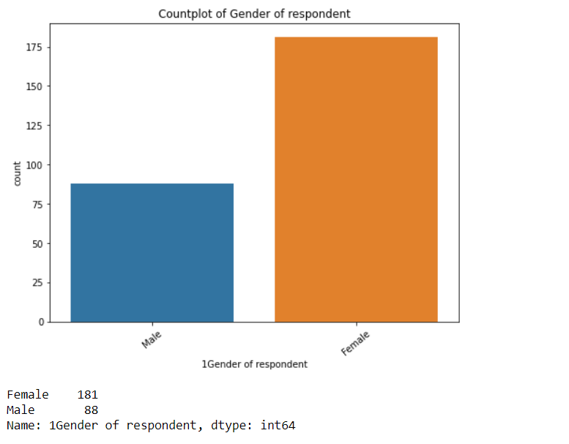
Data analysis
Observation:
As per dataset, female participants are more. Female consists of 181 Nos. while Male are 88.

Slide 8
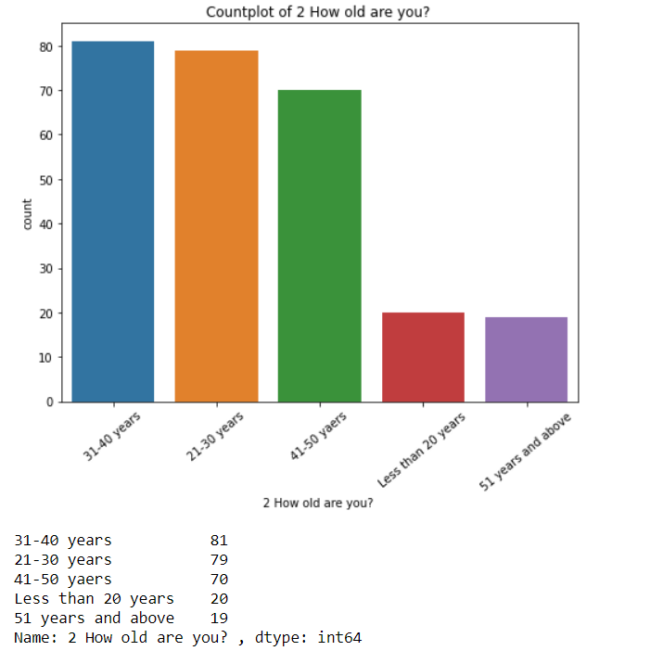
Observation:
We can see that most of the people are in age group of 31-40 years who have participated in survey followed by 21-30 Years

Slide 9
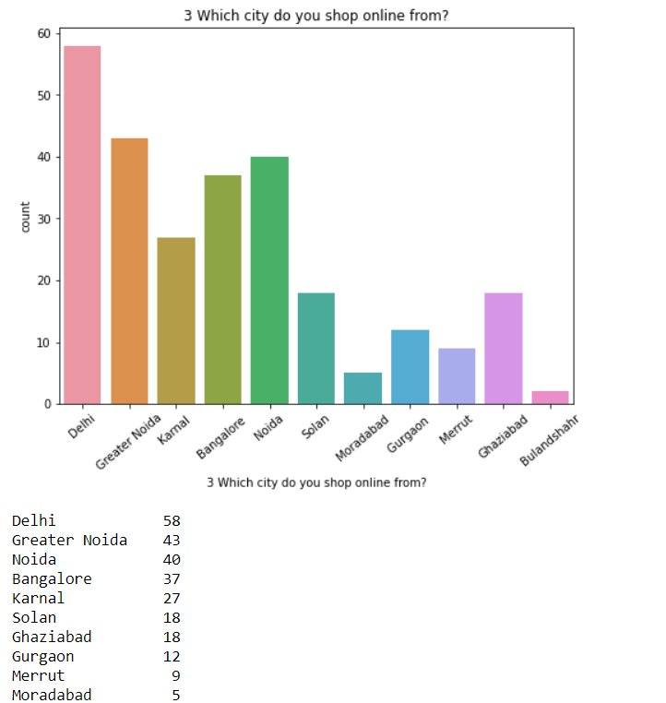
Observation:
Delhi has the maximum buyers followed by Greater Noida and Noida

Slide 10
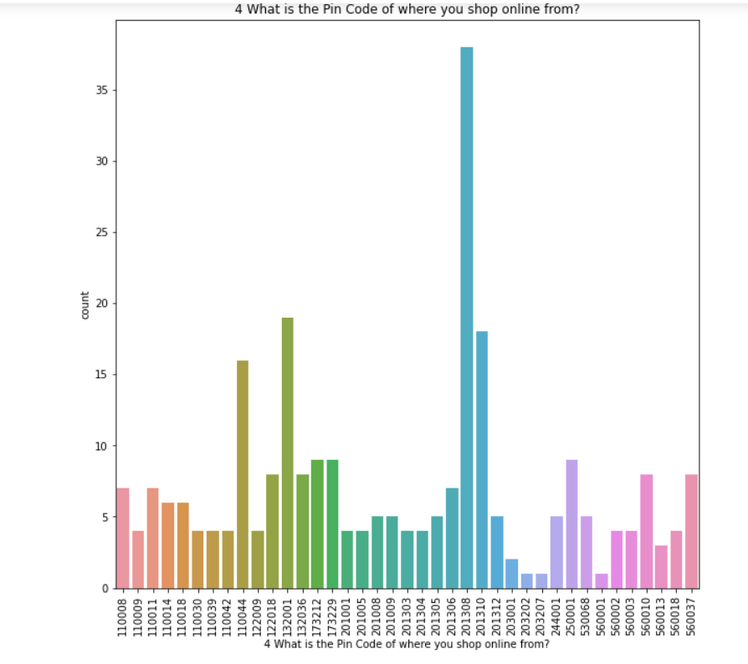
Observation:
The persons from pincode 201308 has done maximum Shopping.

Slide 11
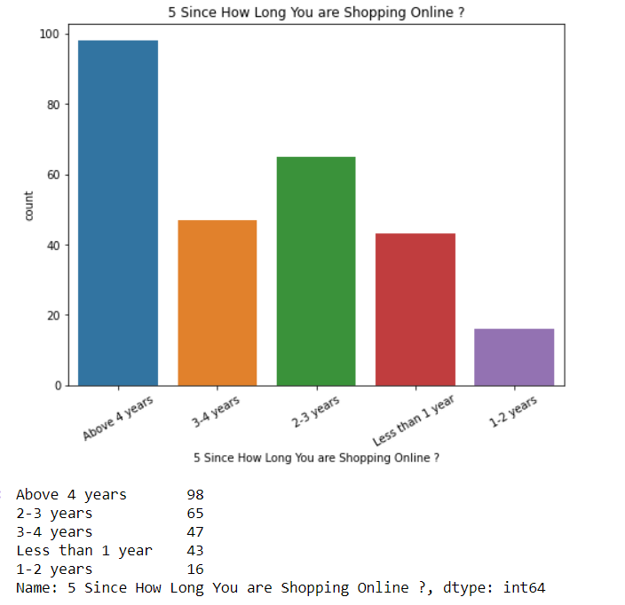
Observation:
Most of the people have done online shopping with above 4 Yrs.

Slide 12
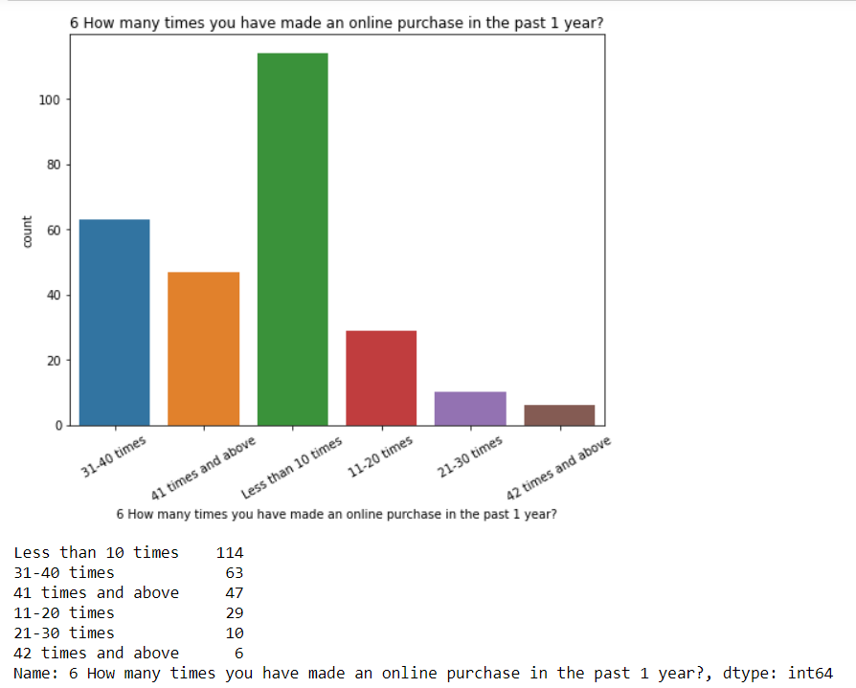
Observation:
114 of the customers have made less than 10 times online purchase in the past 1 year.

Slide 13
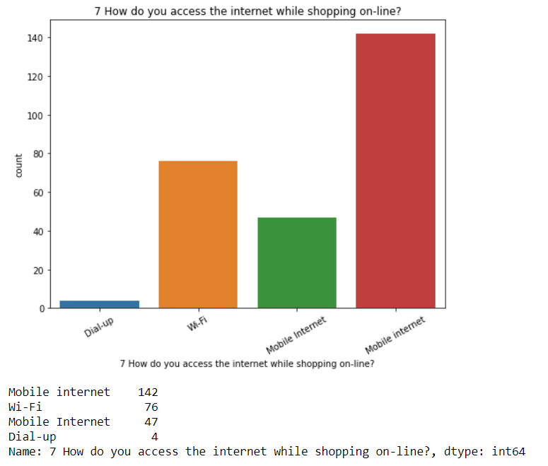
Observation:
Most of the people prefer Mobile Internet for online Shopping followed by WiFi and Mobile Internet

Slide 14
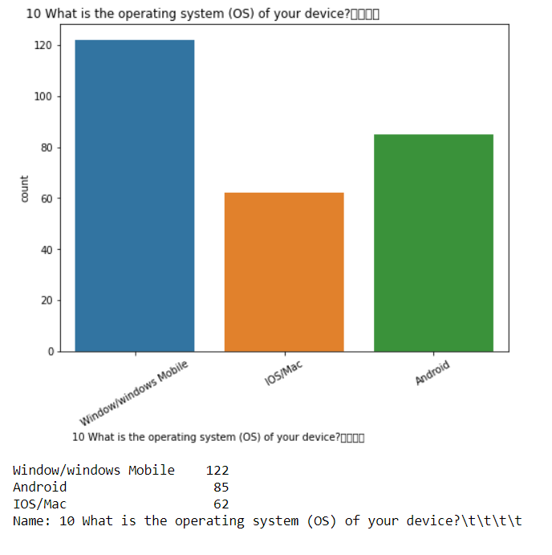
Observation:
122 customers are using Window/windows mobile

Slide 15
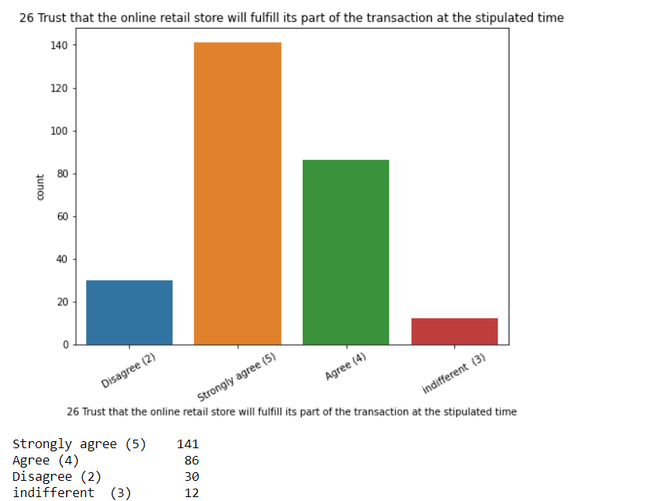
Observation:
Most of the customers Strongly agree that the online retail store will fulfill its part of the transaction at the stipulated time

Slide 16
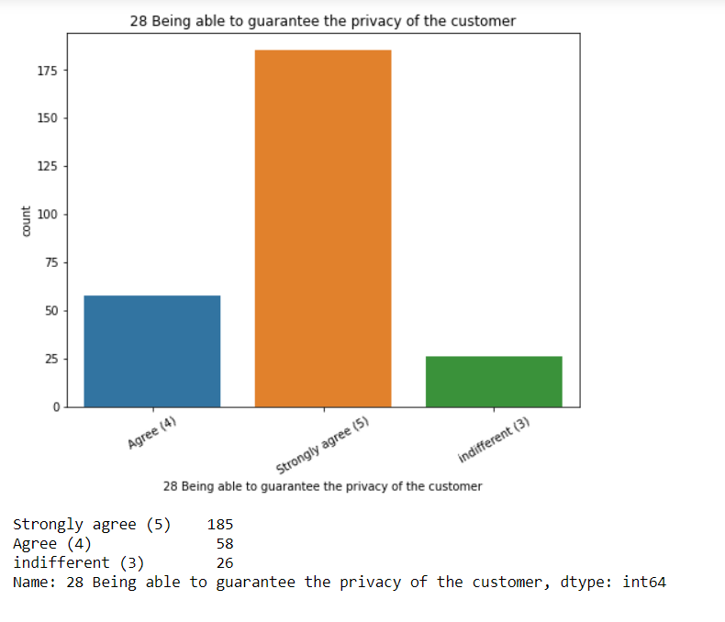
Observation:
Most of the customers strongly agree that the customer privacy is important.

Slide 17
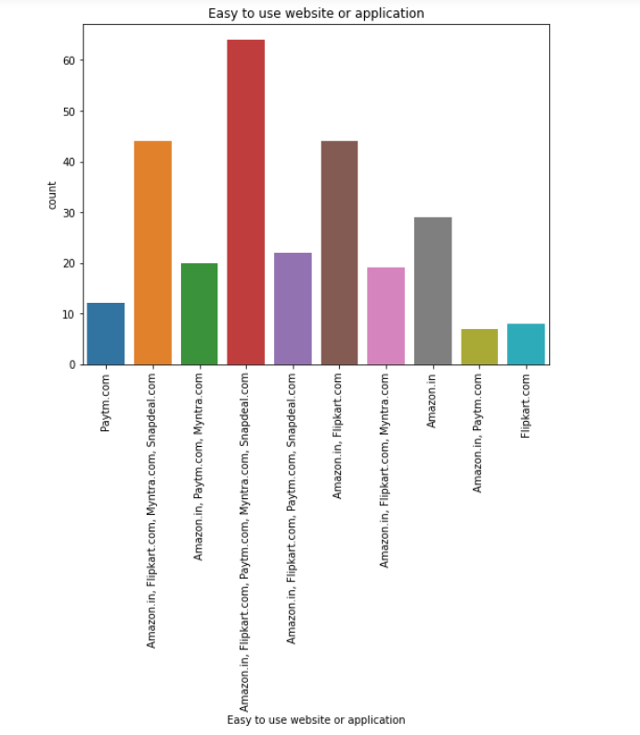
Observation:
64 customers agree that Amazon.in, Flipkart.com, Paytm.com, Myntra.com, Snapdeal.com are Easy to use website or application

Slide 18
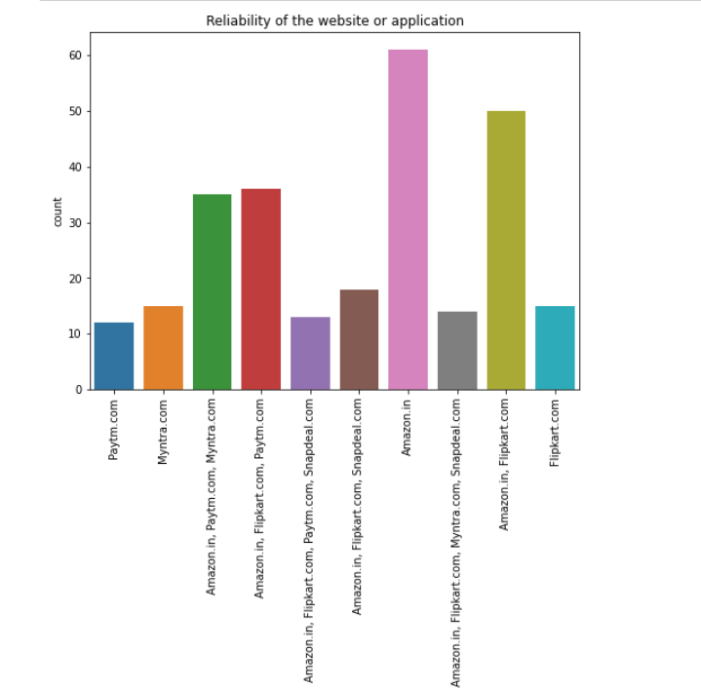
Observation:
61 customers agree that Amazon.in Reliability of the website or application

Slide 19
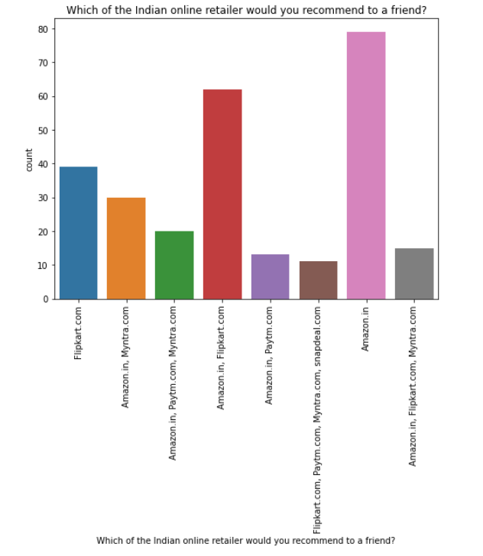
Observation:
79 customers agree to Amazon.in to recommend to a friend

Slide 20
How to Improve Customer Retention
A. Set customer expectations – Set customer expectations early and a little lower than you can provide to eliminate uncertainty about the level of your service and ensure you always deliver on your promises.
B. Become the customers’ trusted advisor – You need to be the expert in your particular field, so that you can gain customers’ trust and build customer loyalty.
C. Use relationships to build trust – Build relationships with customers in a way that fosters trust. Do this through shared values and fostering customer relationships.

Slide 21
D. Take a proactive approach to customer service – Implement anticipatory service so that you can eliminate problems before they occur.
E. Use social media to build relationships – Use LinkedIn, Twitter, and Facebook to connect and communicate with customers and give them a space for sharing experiences with your company, so they can become brand ambassadors.
F. Go the extra mile – Going above and beyond will build strong relationships with customers and build long-term loyalty by paying attention to their needs and issues.

Slide 22
G. Make it personal – Personalized service improves customer experience and is something customers are expecting and demanding. Make their experience personal to strengthen the bond with your brand.

Slide 23
Conclusion
Retention analysis is an integral part of your customer retention and marketing strategies. By taking full advantage of the data you collect by tracking customer behavior, requesting feedback, and studying important metrics, you can decrease the churn rate, improve customer satisfaction, and boost your revenue.

Slide 24
Limitations of this work and Scope for Future Work
We are able to properly analyse the valuable feedback of the customers but given, the dataset was very small as it may result in less understanding. If we are able to increase the feedbacks from more customers all over it would provide a great understanding of the strategies we will have to use to improve customer retention.

